Slide 1
Edited on: Summer 2020

Slide 5
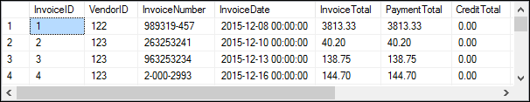

Slide 6


Slide 7


Slide 8
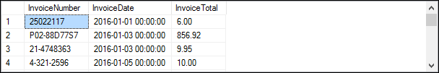

Slide 13
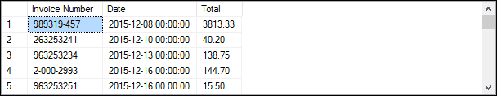

Slide 14
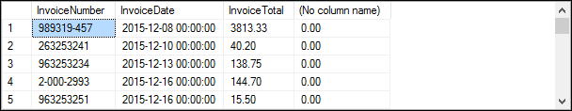

Slide 15


Slide 16
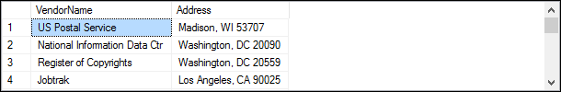

Slide 17
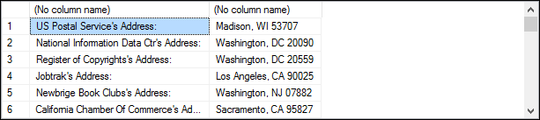

Slide 19


Slide 20


Slide 21


Slide 23


Slide 25


Slide 27
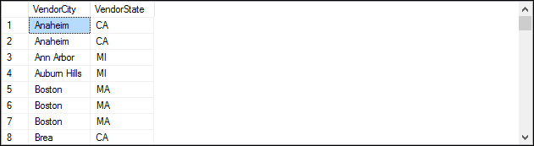

Slide 28
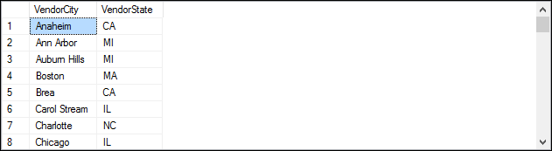

Slide 29
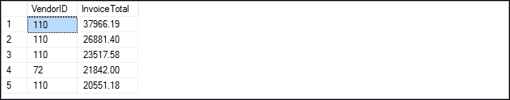

Slide 30
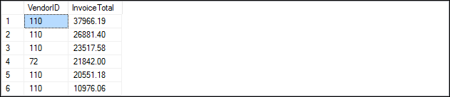

Slide 31
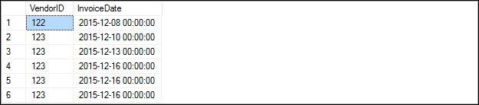
Used when you want to return two or more rows that tie for last place in the limited results set.

Slide 35
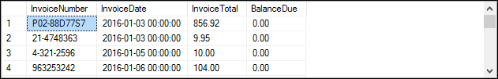

Slide 36
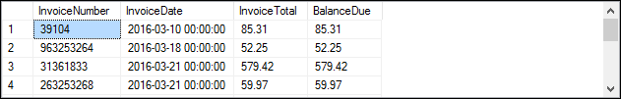

Slide 43
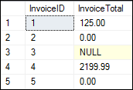

Slide 44



Slide 45



Slide 46


Slide 48


Slide 49
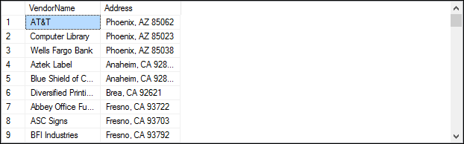

Slide 50


Slide 51


Slide 52


Slide 53
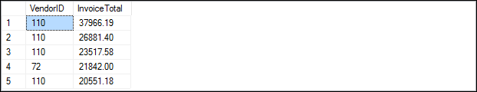
Specifies the number of rows to skip before it starts to return rows from the query expression.

Slide 54
